Slide 1
1
FUNCTIONS AND LIMITS

Slide 2
1.3
The Limit of a Function

Slide 3
Example 1
Suppose that a ball is dropped from the upper observation deck of the CN Tower in Toronto, 450 m above the ground. Find the velocity of the ball after 5 seconds.
Solution:
Through experiments carried out four centuries ago, Galileo discovered that the distance fallen by any freely falling body is proportional to the square of the time it has been falling. (This model for free fall neglects air resistance.)

Slide 4
Example 1 – Solution
cont’d
If the distance fallen after t seconds is denoted by s (t ) and measured in meters, then Galileo’s law is expressed by the equation
s (t ) = 4.9t ²
The difficulty in finding the velocity after 5 s is that we are dealing with a single instant of time (t = 5), so no time interval is involved.

Slide 5
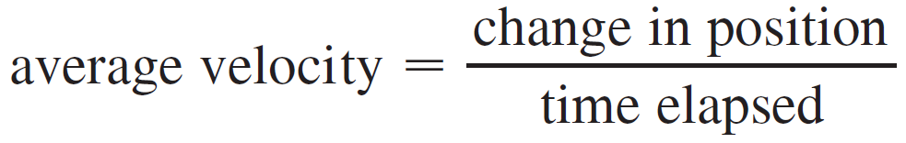
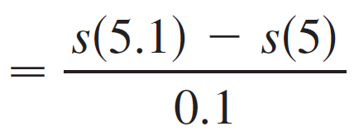
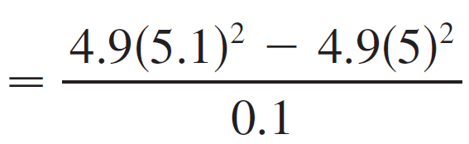

Example 1 – Solution
cont’d
However, we can approximate the desired quantity by computing the average velocity over the brief time interval of a tenth of a second from t = 5 to t = 5.1:

Slide 6
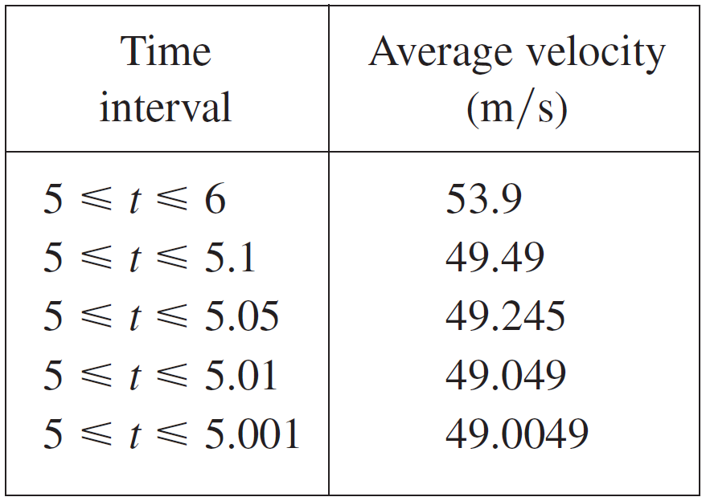
Example 1 – Solution
cont’d
The table shows the results of similar calculations of the average velocity over successively smaller time periods.
It appears that as we shorten the time period, the average velocity is becoming closer to 49 m/s.

Slide 7

Example 1 – Solution
cont’d
The instantaneous velocity when t = 5 is defined to be the limiting value of these average velocities over shorter and shorter time periods that start at t = 5.
Thus the (instantaneous) velocity after 5 s is

Slide 8
Intuitive Definition of a Limit

Slide 9
Intuitive Definition of a Limit
Let’s investigate the behavior of the function f defined by f(x) = x² – x + 2 for values of x near 2.
The following table gives values of f(x) for values of x close to 2, but not equal to 2.

Slide 10
Intuitive Definition of a Limit
From the table and the graph of f (a parabola) shown in the figure, we see that, when x is close to 2 (on either side of 2), f(x) is close to 4.

Slide 11
Intuitive Definition of a Limit
In fact, it appears that we can make the values of f(x) as close as we like to 4 by taking x sufficiently close to 2.
We express this by saying “the limit of the function f(x) = x² – x + 2 as x approaches 2 is equal to 4.”
The notation for this is:

Slide 12
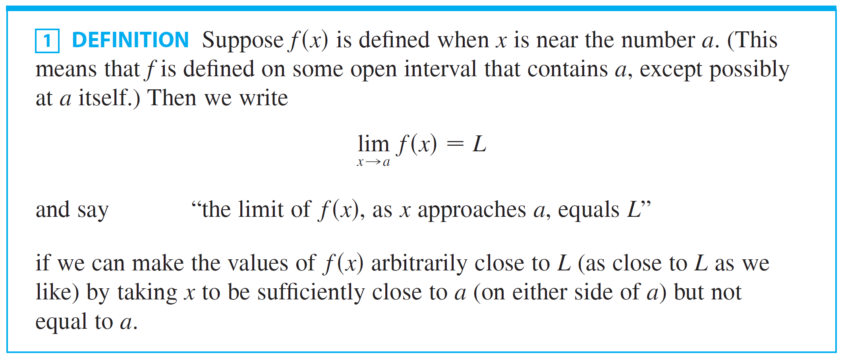
Intuitive Definition of a Limit
In general, we use the following notation.

Slide 13
Intuitive Definition of a Limit
Roughly speaking, this says that the values of f(x) tend to get closer and closer to the number L as x gets closer and closer to the number a (from either side of a) but x ≠ a.
An alternative notation for is as which is usually read “f(x) approaches L as x approaches a.”

Slide 14
THE LIMIT OF A FUNCTION
Notice the phrase “but x ≠ a” in the definition of limit.
This means that, in finding the limit of f(x) as x approaches a, we never consider x = a.
In fact, f(x) need not even be defined when x = a.
The only thing that matters is how f is defined near a.

Slide 15
THE LIMIT OF A FUNCTION
The figure shows the graphs of three functions.
Note that, in the third graph, f(a) is not defined and, in the second graph, .
However, in each case, regardless of what happens at a, it is true that

Slide 16
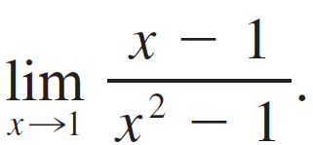


Example 2
Guess the value of
Solution:
Notice that the function is not defined when x = 1, but that doesn’t matter because the definition of says that we consider values of x that are close to a but not equal to a.

Slide 17
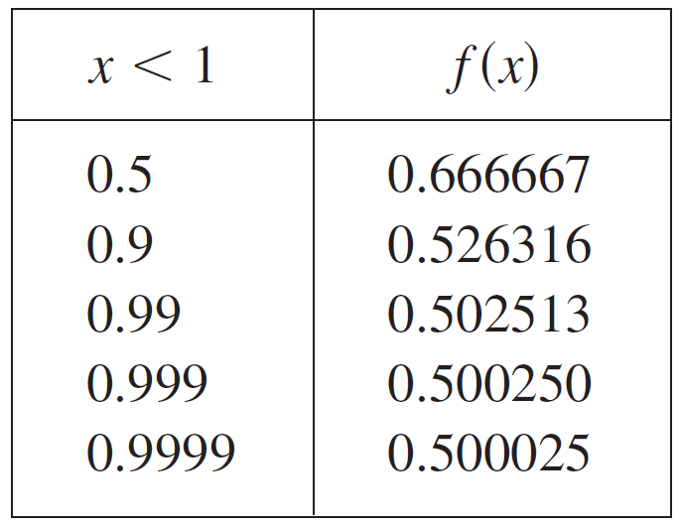
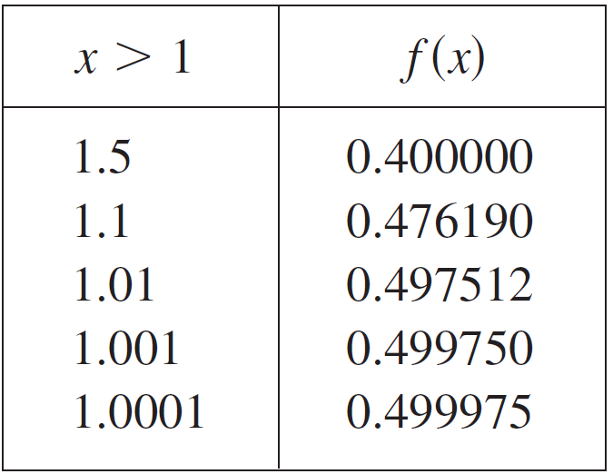
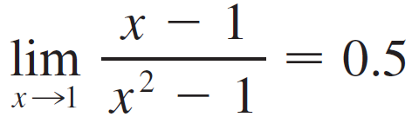
Example 2 – Solution
cont’d
The tables below give values of f (x ) (correct to six decimal places) for values of x that approach 1 (but are not equal to 1).
On the basis of the values in the tables, we make the guess that

Slide 18
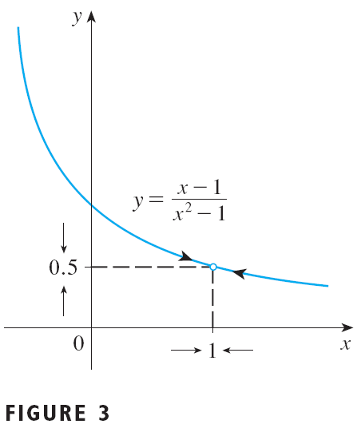
Example 2 – Solution
Example 2 is illustrated by the graph of f in the figure.

Slide 19
Example 2 – Solution
Now, let’s change f slightly by giving it the value 2 when x = 1 and calling the resulting
function g :
This new function g still has the same limit as x approaches 1.

Slide 20
Example 3
Estimate the value of .
SOLUTION
The table lists values of the function for several values of t near 0.
As t approaches 0, the values of the function seem to approach 0.16666666…
So, we guess that:

Slide 21
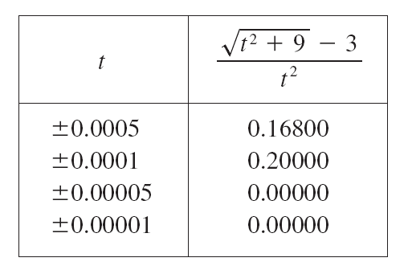
Example 3 – Solution
What would have happened if we had taken even smaller values of t?
The table shows the results from one calculator.
You can see that something strange seems to be happening.
If you try these calculations on your own calculator, you might get different values but, eventually, you will get the value 0 if you make t sufficiently small.

Slide 22
Example 3 – Solution
Does this mean that the answer is really 0 instead of 1/6?
No, the value of the limit is 1/6, as we will show in the next section.
The problem is that the calculator gave false values because is very close to 3 when t is small.
In fact, when t is sufficiently small, a calculator’s value for
is 3.000… to as many digits as the calculator is capable of carrying.

Slide 23
Example 3 – Solution
Something very similar happens when we try to graph the function of the example on a graphing calculator or computer.

Slide 24
Example 3 – Solution
These figures show quite accurate graphs of f and, when we use the trace mode (if available), we can estimate easily that the limit is about 1/6.

Slide 25
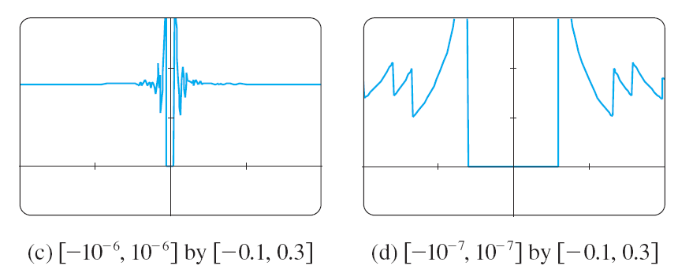
Example 3 – Solution
However, if we zoom in too much, then we get inaccurate graphs—again because of problems with subtraction.

Slide 26
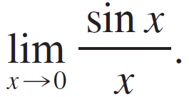


Example 4
Guess the value of
Solution:
The function is not defined when x = 0.
Using a calculator (and remembering that, if ,
sin x means the sine of the angle whose radian measure is ), we construct the table of values correct to eight decimal places.

Slide 27
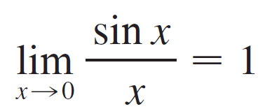
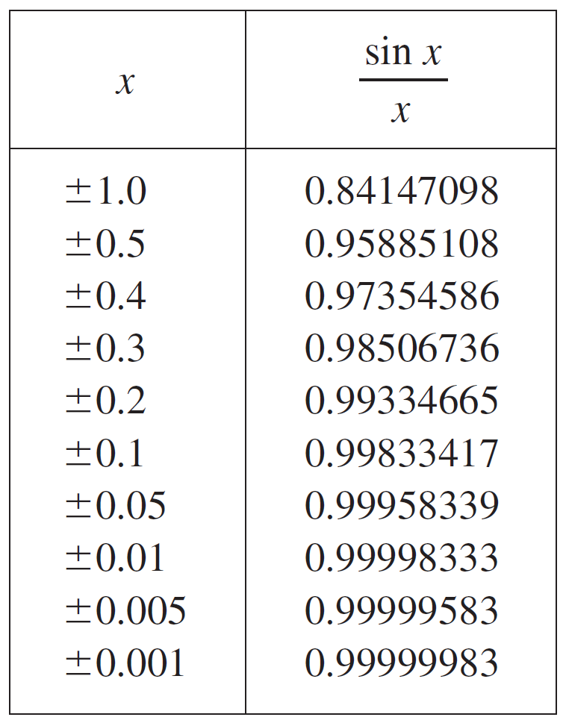
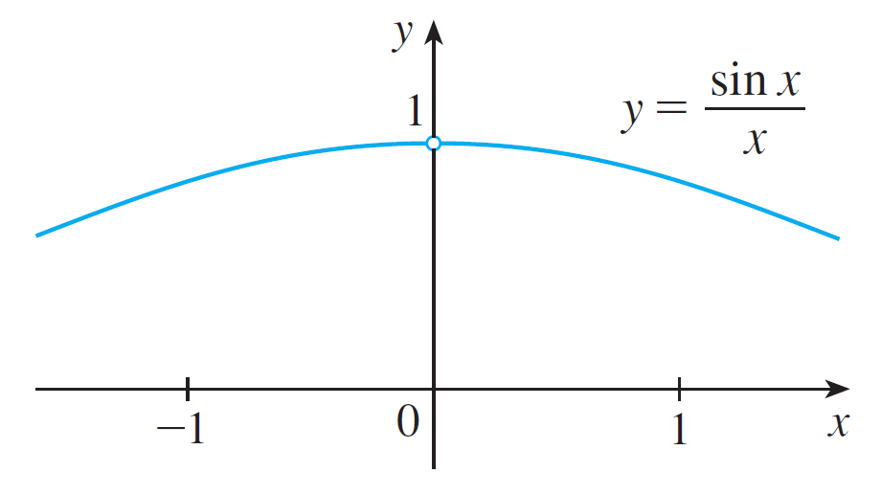
Example 4 – Solution
cont’d
From the table below and the graph in Figure 6 we guess that
This guess is in fact correct, as will be
proved in the next section using a
geometric argument.
Figure 6

Slide 28
Example 5
Investigate .
SOLUTION
Again, the function of f(x) = sin (π /x) is undefined at 0.

Slide 29
Example 5 – Solution
Evaluating the function for some small values of x, we get:
Similarly, f(0.001) = f(0.0001) = 0.

Slide 30
Example 5 – Solution
On the basis of this information, we might be tempted to guess that .
This time, however, our guess is wrong.
Although f(1/n) = sin nπ = 0 for any integer n, it is also true that f(x) = 1 for infinitely many values of x that approach 0.

Slide 31
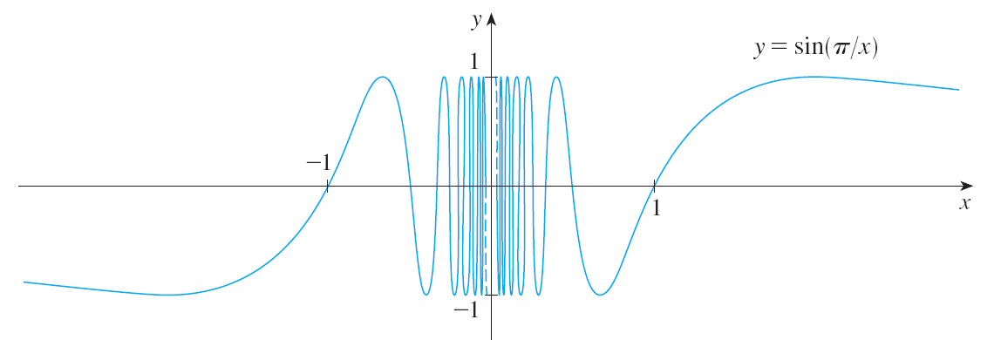
Example 5 SOLUTION
The graph of f is given in the figure.
The dashed lines near the y-axis indicate that the values of sin(π/x) oscillate between 1 and –1 infinitely as x approaches 0.

Slide 32
Example 5 – Solution
Since the values of f(x) do not approach a fixed number as approaches 0, does not exist.

Slide 33
Example 5 – Solution
Examples 3 and 5 illustrate some of the pitfalls in guessing the value of a limit.
It is easy to guess the wrong value if we use inappropriate values of x, but it is difficult to know when to stop calculating values.
As the discussion after Example 2 shows, sometimes, calculators and computers give the wrong values.
In the next section, however, we will develop foolproof methods for calculating limits.

Slide 34
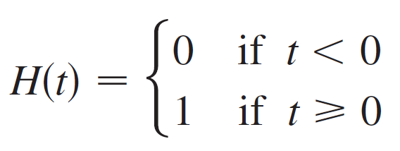
Example 6
The Heaviside function H is defined by
This function is named after the electrical engineer Oliver Heaviside (1850–1925) and can be used to describe an electric current that is switched on at time t = 0.

Slide 35
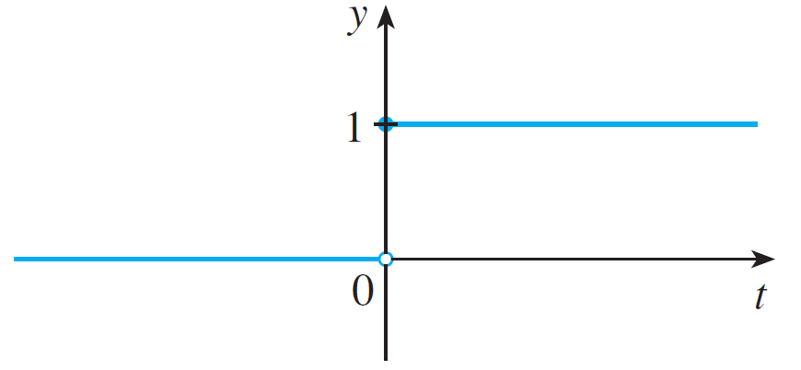

Example 6– Solution
Its graph is shown in Figure 8.
As t approaches 0 from the left, H (t ) approaches 0.
As t approaches 0 from the right, H (t ) approaches 1. There is no single number that H (t ) approaches as t approaches 0.
Therefore does not exist.
Figure 8

Slide 36
One-sided Limits

Slide 37
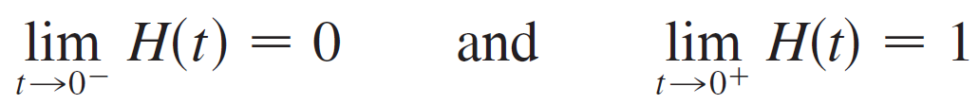


One-sided Limits
We noticed in Example 6 that H (t ) approaches 0 as t approaches 0 from the left and H (t ) approaches 1 as t approaches 0 from the right.
We indicate this situation symbolically by writing
The symbol indicates that we consider only values of t that are less than 0. Likewise, indicates that we consider only values of t that are greater than 0.

Slide 38
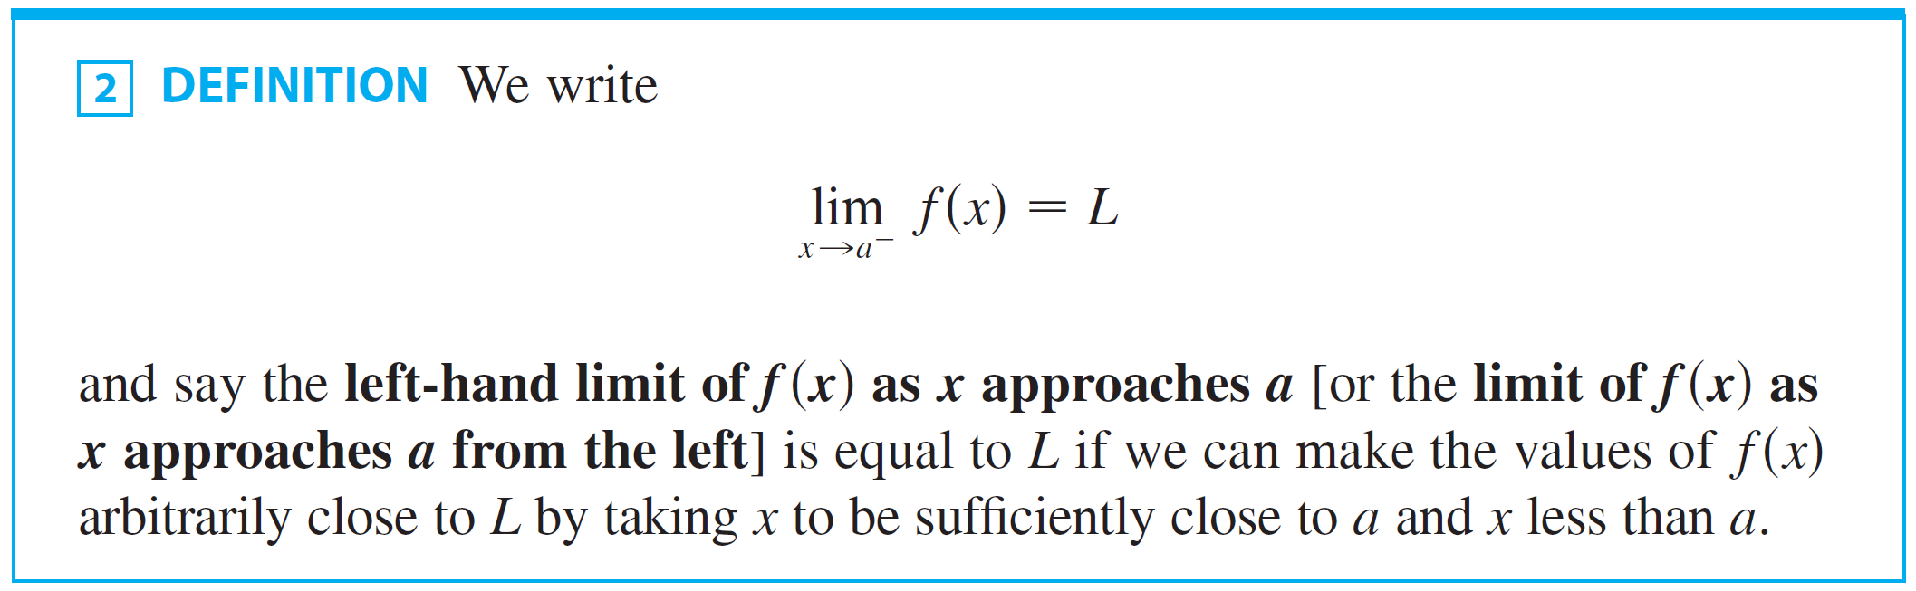
One-sided Limits
Notice that Definition 2 differs from Definition 1 only in that we require x to be less than a.

Slide 39
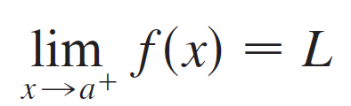

One-sided Limits
Similarly, if we require that x be greater than a, we get “the right-hand limit of f (x ) as x approaches a is equal to L” and we write
Thus the symbol means that we consider only x > a.

Slide 40
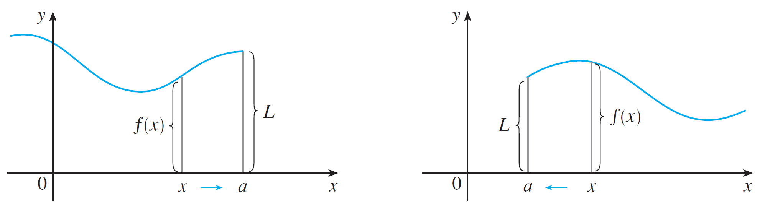


One-sided Limits
These definitions are illustrated in Figure 9.
(a)
(b)
Figure 9

Slide 41
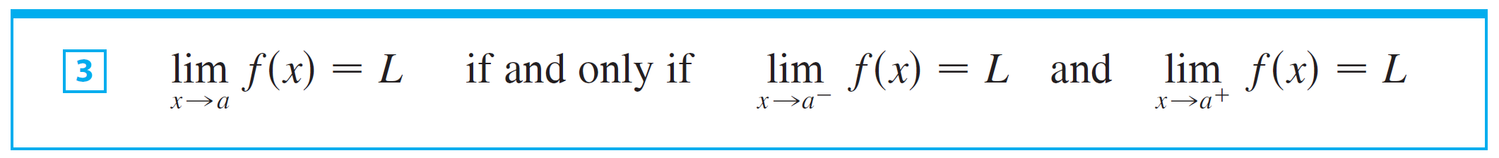
One-sided Limits
By comparing Definition l with the definitions of one-sided limits, we see that the following is true.

Slide 42

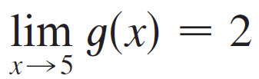
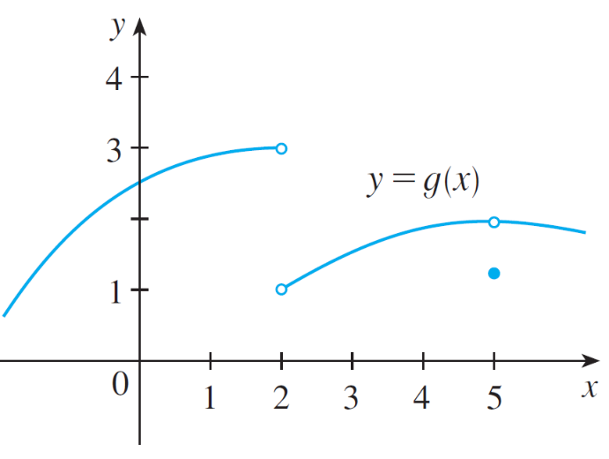
Example 7
The graph of a function g is shown in Figure 10. Use it to state the values (if they exist) of the following:
(a) (b) (c)
(d) (e) (f)
Figure 10

Slide 43

Example 7 – Solution
From the graph we see that the values of g(x) approach 3 as x approaches 2 from the left, but they approach 1 as x approaches 2 from the right.
Therefore
(a) and (b)
(c) Since the left and right limits are different, we conclude from that does not exist.

Slide 44
Example 7 – Solution
cont’d
The graph also shows that
(d) and (e)
(f) This time the left and right limits are the same and so, by , we have
Despite this fact, notice that g(5) ≠ 2.

Slide 45
Example 8
Find if it exists.
SOLUTION
As x becomes close to 0, x² also becomes close to 0, and 1/x² becomes very large.

Slide 46
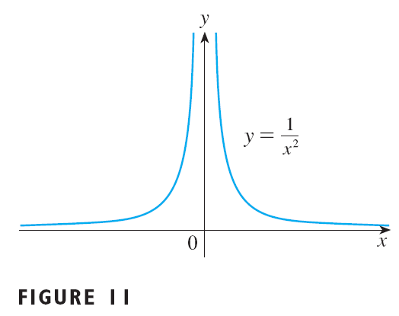
Example 8 – Solution
In fact, it appears from the graph of the function f(x) = 1/x² that the values of f(x) can be made arbitrarily large by taking x close enough to 0.
Thus, the values of f(x) do not approach a number.
So, does not exist.

Slide 47
Precise Definition of a Limit

Slide 48

Precise Definition of a Limit
We want to express, in a quantitative manner, that f (x) can be made arbitrarily close to L by taking x to be sufficiently close to a (but x ≠ a).
This means that f (x) can be made to lie within any preassigned distance from L (traditionally denoted by ε, the Greek letter epsilon) by requiring that x be within a specified distance δ (the Greek letter delta) from a.
That is, Notice that we can stipulate that x ≠ a by writing

Slide 49
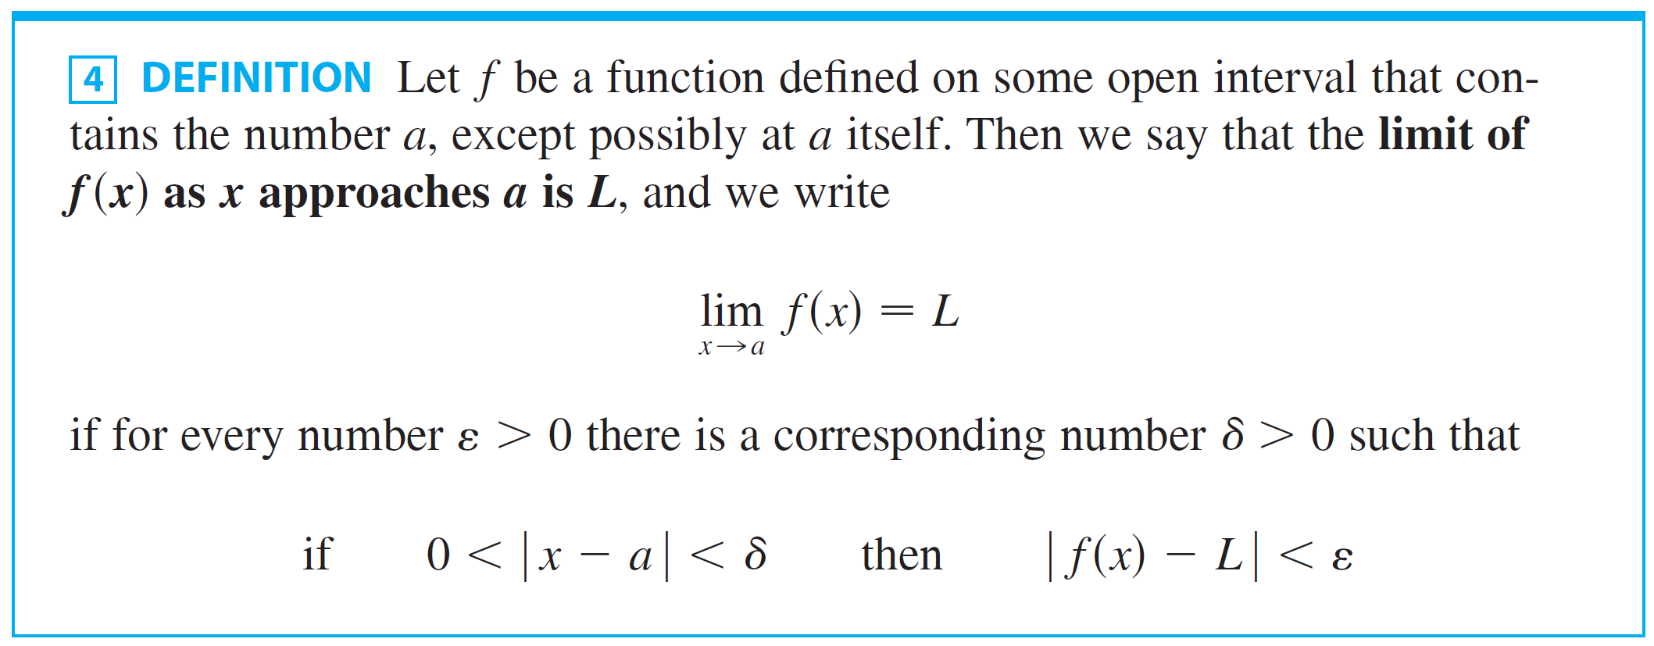
Precise Definition of a Limit
The resulting precise definition of a limit is as follows.

Slide 50

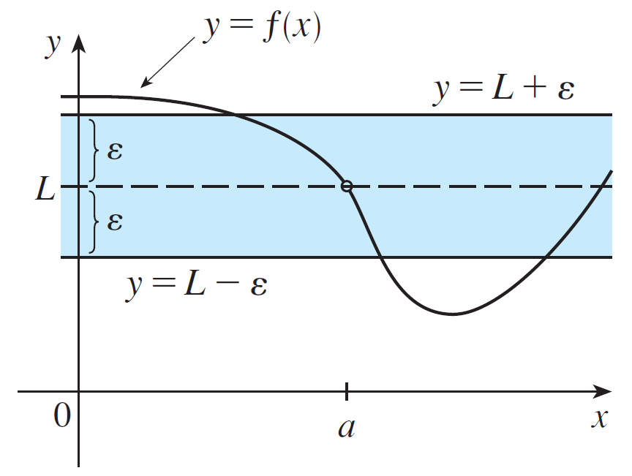
Precise Definition of a Limit
Definition 4 is illustrated in Figures 12 –14.
If a number ε > 0 is given, then we draw the horizontal lines and the graph of f. (See Figure 12.)
Figure 12

Slide 51


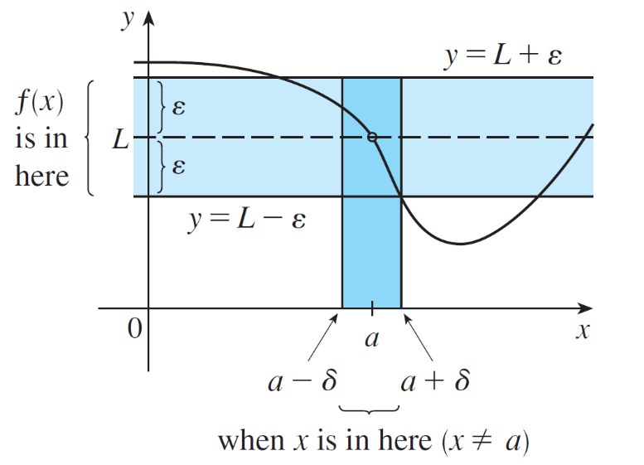
Precise Definition of a Limit
If then we can find a number δ > 0 such that if we restrict x to lie in the interval and take x ≠ a, then the curve y = f (x) lies between the lines (See Figure 13.) You can see that if such a δ has been found, then any smaller δ will also work.
Figure 13

Slide 52

Precise Definition of a Limit
It’s important to realize that the process illustrated in Figures 12 and 13 must work for every positive number ε, no matter how small it is chosen.
Figure 12
Figure 13

Slide 53
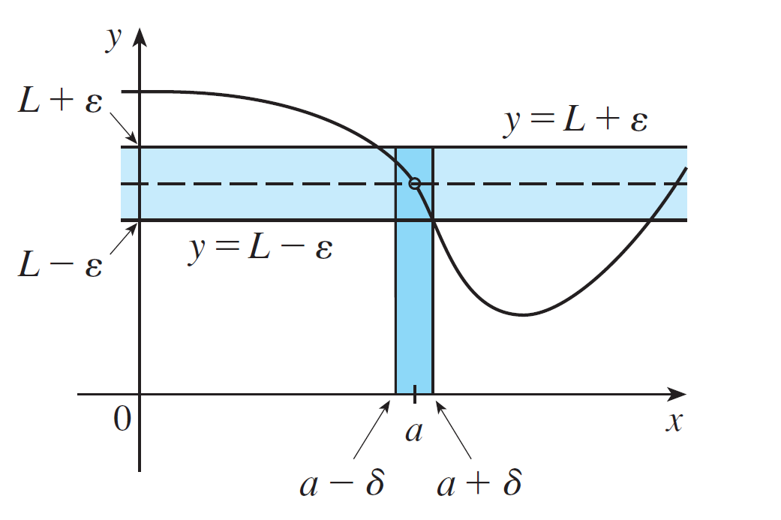
Precise Definition of a Limit
Figure 14 shows that if a smaller ε is chosen, then a smaller δ may be required.
Figure 14

Slide 54
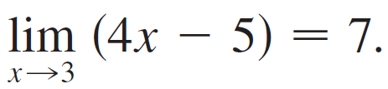
Example 9
Prove that
Solution:
Let ε be a given positive number. According to Definition 4 with a = 3 and L = 7, we need to find a number δ such that
\
Therefore we want:

Slide 55

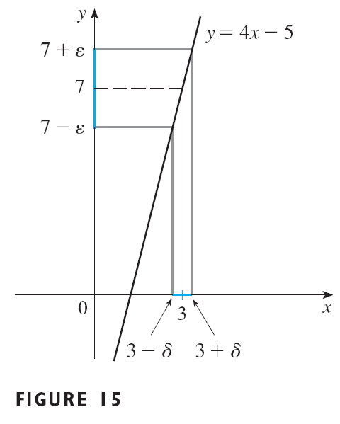
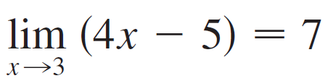
Example 9 – Solution
cont’d
Note that
So let’s choose
We can then write the following:
Therefore, by the definition of a limit,

Slide 56
Example 10
Prove that
SOLUTION
Let ε be a given positive number. We want to find a number δ such that if 0 < x < δ then

Slide 57
Example 10 – Solution
But . So if we choose δ = ε² and 0 < x < δ = ε², then . (See Figure 16.) This shows that

